Slide 1
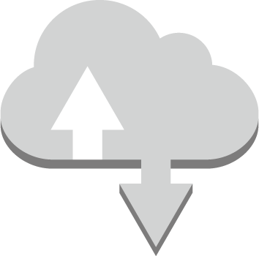
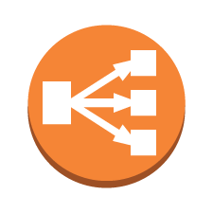

TigerMed Company: Current Environment (Reference for Architecture and Capacity Planning)
Web Tier:
Two physical servers (Two CPUs / 4-GB memory)
Microsoft Windows 2016 Base with Internet Information Services (IIS)
High Availability load balancer used to balance traffic between the web servers
Web Tier –
2 CPUs,
4-GB memory,
MS Windows
Web Tier –
2 CPUs,
4-GB memory,
MS Windows
Application Tier:
Two physical servers (Four CPUs / 16-GB memory)
Microsoft Windows 2016 Base with Internet Information Services (IIS)
High Availability load balancer used to balance traffic between app servers
Database Tier:
One physical server (Eight CPUs / 32-GB memory / 5-TB storage)
SQL Server Standard Edition with Microsoft Windows 2016 Base
DBAs access and manage the database, but no RDMBS or advanced configuration is required.
App Tier –
4 CPUs,
16-GB memory,
MS Windows
App Tier –
4 CPUs,
16-GB memory,
MS Windows
Database Tier –
8 CPUs, 32-GB memory, 5-TB storage,
MS Windows, SQL Server SE
Notes:
TigerMed has provided this architectural diagram of their current system
The current architecture has three tiers: a web tier, an application tier, and a database tier. Here is the current hardware implementation:
Web Tier
Two physical servers (Two CPUs / 4-GB memory)
Microsoft Windows 2016 Base with Internet Information Services (IIS)
High availability load balancer used to balance traffic between the web servers
Application Tier
Two physical servers (Four CPUs / 16-GB memory)
Microsoft Windows 2016 Base with Internet Information Services (IIS)
High availability load balancer used to balance traffic between app servers
Database Tier
One physical server (Eight CPUs / 32-GB memory / 5-TB storage)
SQL Server Standard Edition with Microsoft Windows 2016 Base
DBAs access and manage the database, but no RDMBS or advanced configuration is required

Slide 2
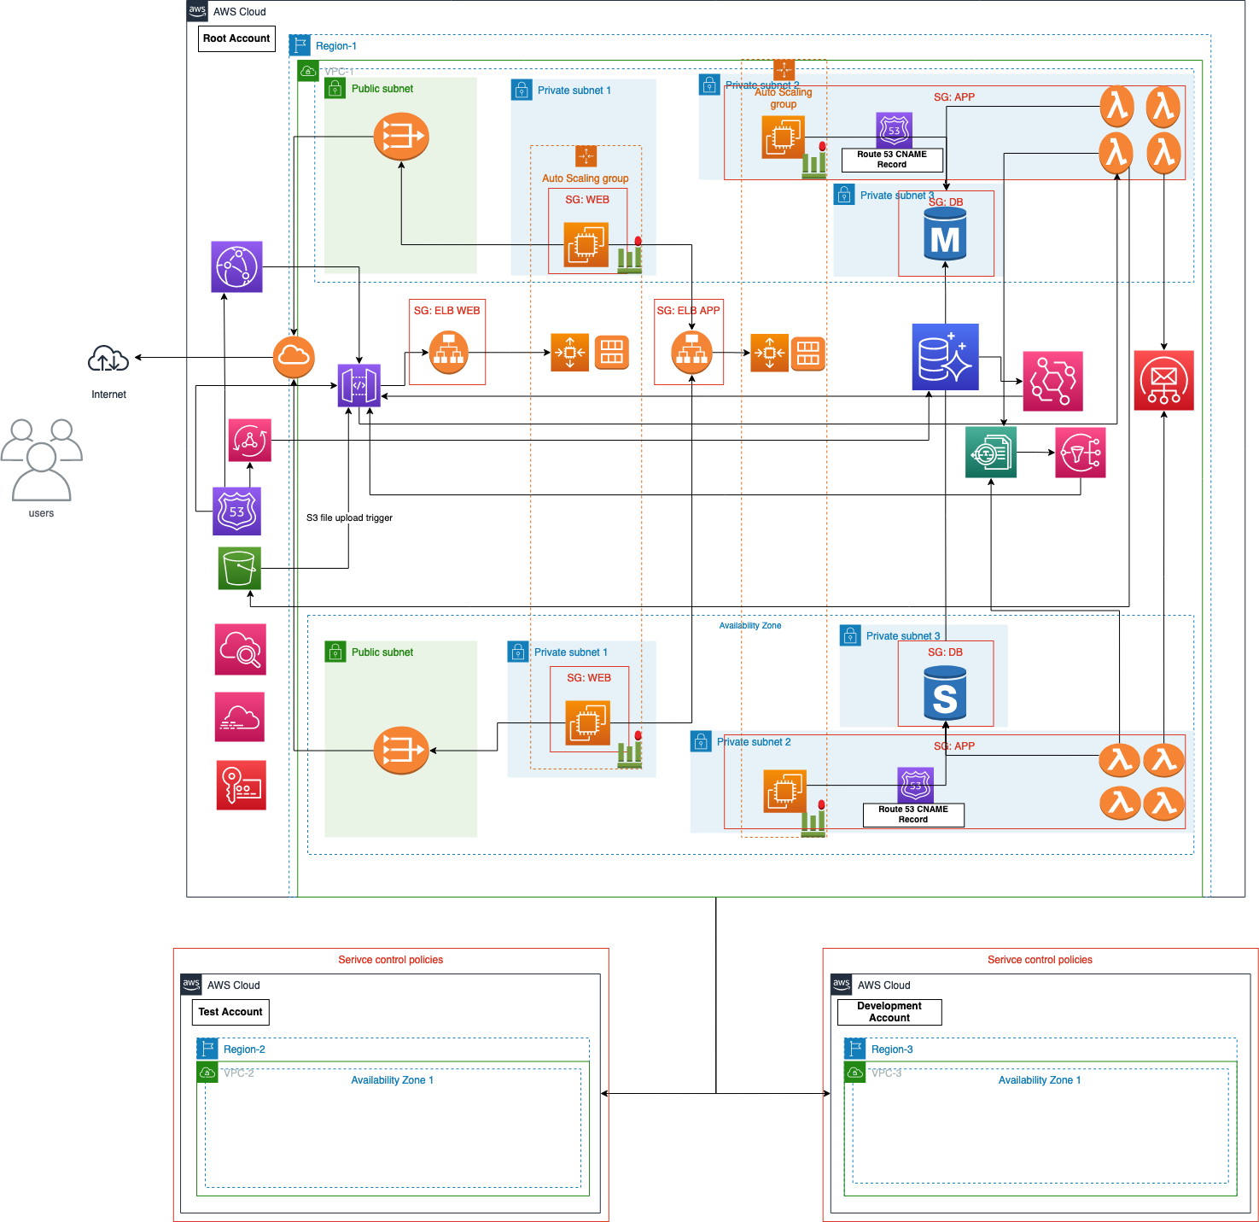
Proposed Architecture

Slide 3
Quick Notes
We have purposefully not included the Availability Zone 2 for Development and Testing environment because we found no good reason. Everything we spanned across availability zone is AWS managed services so, there is no moving parts to test from our end.

Slide 4
Potential Services
These are the POTENTIAL services we are proposing to use in order to move the TigerMed’s current environment to AWS.
Route 53: This service is to configure the custom domain. Useful for customers to access TigerMed using meaningful domain name.
CloudFront: The serve cached statics like media, images, fonts, etc.
API Gateway, NAT Gateway, Internet Gateway: For Ingress and Egress.
Application Load balancer: Load balance traffic to Web & App servers.
EC2 Auto scaling: To autoscale Web & App instances on demand.
EC2 Instances: Actual Web & App instances.
Amazon Aurora: Managed RDS database service.
APP Sync: To power chat service for remote consultation and diagnosis.
Event Bridge: To trigger Lambda on post-insert in Aurora Database.
Simple Mail Service: To send appointment confirmation email to customers.
Textract: To extract text from document and images uploaded by customers.
Simple Notification Service: To trigger Lambda on post completion of Textract job.
Lambda: To handle application logic post DB insert, textract job handling etc.
VPC: Network connectivity.
Cloud watch: To monitor and audit (partial) the cluster.
CloudTrail: To governance, compliance, and operational and risk auditing.
KMS: For Authentication.
Notes:
You might start by making a list of potential services and the why they might be used in the new solution.
For example, we know that we need to manage user access and we would use IAM to do that.

Slide 5
Identity and Access Management
Below is the Group, Role and Permission hierarchy we are proposing for authorization
TigerMed Company Account
Group: System Admin
Group: Database Admin
Group: Monitoring
Role: S3 Access
Amos Admeen
Dee Beead
Ida See
Read-Write
Barb Cistems
Ghat Yurdata
Noah Sleep
Isaac Zeeall
Group/Role # | Group/Role Name | Permissions
Group | System Admin | Allow permissions needed to support system and development operations. Access to AWS services other than database and monitoring solutions.
Group | Database Admin | Allow permissions needed to support database operations. Access to Aurora DB service.
Group | Monitoring | Allow permissions needed to support monitoring operation. Access to AWS services CloudWatch, CloudTrail.
Role | S3 Access | Read and Write access permission to S3 bucket.
Notes:
Perhaps you could use a diagram like this to figure that out.

Slide 6
User Authentication
Below is our proposal for additional credential requirements.
Requirement | Solution
Passwords should be at least 8 characters and have 1 uppercase, 1 lowercase, 1 special character, and a number | Using the password policy feature of AWS, We can enforce these rules. The following options we can use. Enforce minimum password length [8] Require at least one uppercase letter from Latin alphabet (A-Z) [enable] Require at least one lowercase letter from Latin alphabet (a-z) [enable] Require at least one number [enable] Require at least one non-alphanumeric character (! @ # $ % ^ & * ( ) _ + - = [ ] { } | ‘) [enable]
Passwords must be changed every 90 days; the last three passwords cannot be reused | Using the password policy feature of AWS, We can enforce these rules. The following options we can use. Enable password expiration [90] Prevent password reuse [Remember 3 password(s)]
All administrators require programmatic access | There is two approach we can follow Add programmatic access while creating the IAM user. To bound programmatic access only to the IAM group, we can add API access to the IAM policy of the IAM group. For example: rds:* allows the console access and rds-data:* provides the programmatic access.
Administrator sign-in to the AWS Management Console requires the use of Virtual MFA | Using IAM policies (for group) with MFA conditions, We can enforce the access of console only with MFA. For example: {……. "Condition": {"Bool": {"aws:MultiFactorAuthPresent": "true"}} }
Notes:
TigerMed Company also has some specific credential requirements. Use a table like this to figure out how to do this using AWS IAM features.

Slide 7
Network Architecture
Use a table like this to work out your network architecture
VPC | Region | Purpose | # of Subnets | # of AZs | VPC CIDR Range
1 | Region-1 Region-1 Region-1 | To isolate Web instances (EC2). Keeping this in a separate subnet helps us to allow external world egress to this subnet alone. This subnet can accommodate 8 hosts (6 usable). To isolate App instances (EC2 and Lambda) from external world. This subnet can accommodate 8 hosts (6 usable). To isolate Database instances (Aurora) from external world. This subnet can accommodate 8 hosts (6 usable). | Private-Subnet-1 Private-Subnet-2 Private-Subnet-3 | AZ-1&2 AZ-1&2 AZ-1&2 | 29 29 29
1 | Region-1 | To allow external world access. In this model, we use this to provide external world access to Web instances alone. This subnet can accommodate 32 hosts (30 usable). | Public Subnet | AZ-1&2 | 27
2 | Region-2 | Purpose is same as the Region-1 but this is completely for testing. | Private-Subnet-1&2&3 Public Subnet | AZ-1 | CIDR Same as Region-1.
3 | Region-3 | Purpose is same as the Region-1 but this is completely for development. | Private-Subnet-1&2&3 Public Subnet | AZ-1 | CIDR Same as Region-1.
Notes:
Use a table like this to work out your network architecture.
Think about TigerMed’s anticipated customers and their geographies. Think also about how you’re going to support development, testing, and production environments.
Within a VPC, what is your subnet strategy? Will you a separate subnet for each tier? Is that necessary? You could credibly defend whatever decision you make on that front.
Remember, not all AWS regions support features like Amazon RDS Multi-AZ deployments with mirroring for SQL Server, for example. That might affect which Regions you use.

Slide 8
Web and Application Tier
Below is our capacity proposal for web, app and db instances.
Tier | Tags* | OS | Instance Type | Justification | # of instances | User Data? Y/N
Web | name:web | Windows | t3.medium | It has 2 vCPU and 4 GB of RAM. Capacity similar to previous machines. | 2 | N
App | name:app | Windows | t3.xlarge | It has 4 vCPU and 16 GB of RAM. Capacity similar to previous machines. | 2 | N
DB | name:db | Windows | db.t3.2xlarge | It has 8 vCPU and 32 GB of RAM. Capacity similar to previous machines. It supports EBS. | 2 (main and standby) | Y
Notes:
Use a table like this to document your choices. What operating system will they run? How capable of a server instance do they need? How many?
Will you need User Data to bootstrap the installation of additional software after your servers initialize? Probably so, since both the web and app tier servers need to have Microsoft IIS installed if your AMI doesn’t include them.
Here’s an example of some bootstrap code that can be used to install IIS via User Data bootstrapping when launching an instance.
<powershell>
Set-ExecutionPolicy Unrestricted -Force
New-Item -ItemType directory -Path 'C:\temp'
# Install IIS and Web Management Tools.
Import-Module ServerManager
install-windowsfeature web-server, web-webserver -IncludeAllSubFeature
install-windowsfeature web-mgmt-tools
</powershell>

Slide 9
Security Groups
Below is our inbound rule proposal for web, app and db instances.
Security Group | Type | Protocol | Port | Source | Description
Web | Application Load Balancer | HTTP/HTTPS | 80/443 | Anywhere | Any public can access the web instances and they have use case to access HTTP/HTTPS.
App | EC2 Instances, Lambda | HTTP/HTTPS | 80/443 | Private Subnet 1 | Only private subnet 1 can use app instances and they have use case to access HTTP/HTTPS.
DB | Aurora | Custom TCP | 1433 | Private Subnet 2 | Aurora is internal service. Only accessed by resources on the private subnet 2 using custom port 1433.
Notes:
You’ll need security groups to associate with your load balancers and instances. Use a table like this to work out what inbound rules you’ll need for your security groups to meet the requirements.

Slide 10
Answering Questions
What do you need for a high availability environment?
High availability in terms of single region and multiple region is taken in to consideration. To provide high availability in the single region we have added multiple web and app instances and load balanced using application load balancer. Auto scaling group is added in order to scale EC2 instances across regions. We have selected Aurora DB because it is RDS and also AWS managed service which has AZ deployment. This topology will ensure the high availability of web, app and db instances.
What do you need to configure automatic scaling?
Launch template: AMI, Instance type and Security group.
Auto Scaling group.
Elastic Load Balancers (Optional).
Scaling policies (Optional).

Slide 11
Auditing
Our proposal for auditing requirements.
Cloud Trail: We propose this service for three use cases “Audit activity” (Monitor, store, and validate activity events for authenticity. Easily generate audit reports required by internal policies and external regulations), “Identify security incidents” (Detect unauthorized access using the Who, What, and When information in CloudTrail Events. Respond with rules-based Event Bridge alerts and automated workflows) and “Troubleshoot operational issues” (Continuously monitor API usage history using machine learning (ML) models to spot unusual activity in your AWS accounts, and determine root cause) - credit
Access Logs: This is not a service but many services like Load balancers generates the access log which will be useful for audit.
Cloud Watch: Amazon CloudWatch Logs organizes the audit logs into log groups and, within a log group, into log streams. Each log entry is an event. - credit
Notes:
Do some research to determine what services you might use to meet the auditing requirements.

